Slide 1
Arrowhead Framework: EventHandler Based SIB
Jan 10, 2020 Abdullah Aziz

Slide 2
Assignment Problem Statement
Related to Boliden’s SIB (simple integration box).
Need to implement SIB replica or SIB compliant to Arrowhead framework.
SIB is kind of middleware to get events and notify the subscribers.

Slide 3
Boliden’s SIB
The “Simple Integration Box” platform, SIB for short, is an ongoing project aimed at building an Open Source integration platform in NodeJS.
The main idea of the SIB is to build a light weight, flexible and free integration platform on open standards with support for the most common means of system integration.
The platform uses an MQTT transport as a central data conveyer between listeners and callers, which handles the data flow triggering and data collection.
Optionally a sequence can be used to configure and control the flow of messages.

Slide 4
Boliden’s SIB
Listener
Caller
.custom configuration
.custom configuration
Formatter | Publisher
Response Formatter | Subscriber
Publisher | Formatter
Subscriber | Response Formatter
MQTT
Connector
Connector
External Services

Slide 5
Arrowhead Framework
The Arrowhead Framework is addressing IoT based automation. The approach take is that IoT's are abstracted to services. This to enable IoT interoperability in-between almost any IoT's. The creation of automation is based on the idea of local automation clouds.

Slide 6
MANDATORY CORE SERVICES AND SYSTEMS
The ServiceRegistry system
Enables a service provider to publish its service instance(s).
Enables a service consumer to discover service instance(s) it is interested in consuming.
The Authorization system
Enables a service provider to determine what consumer(s) to accept.
The Orchestration system
Enables remote control (orchestration) of which service instance(s) a consumer shall consume.

Slide 7
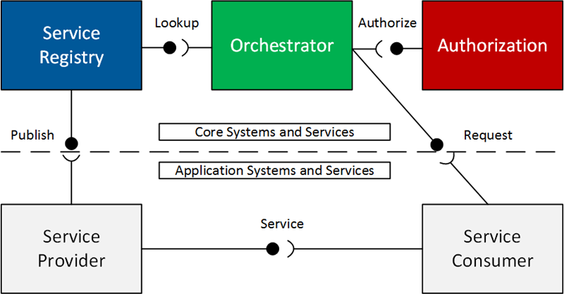
APPLICATION SERVICES AND SYSTEMS

Slide 8
Arrowhead and SIB local cloud
Arrowhead Local Cloud
SIB in Local Cloud
Service Registry
Orchestrator
Authenticator
SIB
Application System B
Listeners
Callers
Application System A
Configuration
Configuration
Formatter
Formatter

Slide 9
Arrowhead and SIB local cloud
Arrowhead Local Cloud
Service Registry
Orchestrator
Authenticator
EventHandler
Provider
Consumer

Slide 10
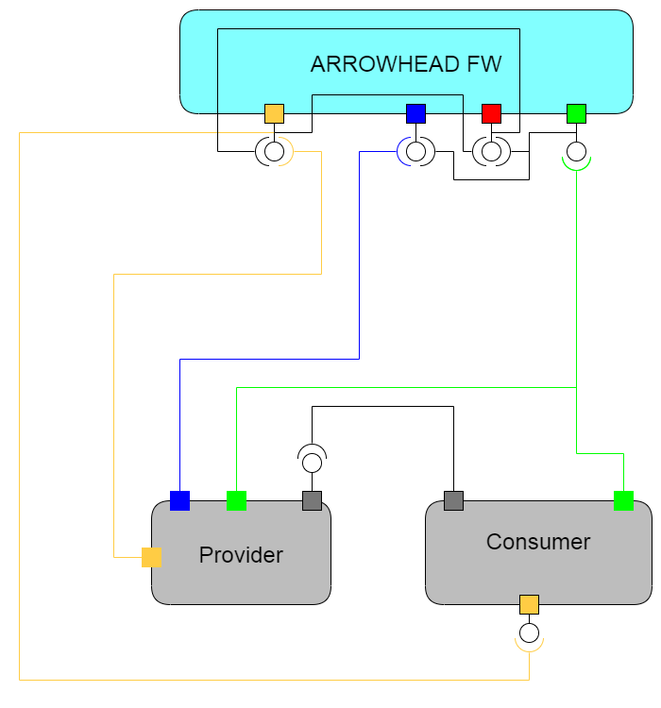
EventHandler in Arrowhead Framework

Slide 11
Project Description
Deploy Arrowhead Core Components.
Deploy EventHandler.
Register Provider (Basic provider and temperature sensor).
Register Consumer (Basic consumer which will consume temperature).
Make consumer authorize to consume Provider services.
Consumer exposes a post endpoint for getting the notification from eventhandler.
Consumer Subscribes to event in eventhandler.
Provider publishes event.
Eventhandler handle event and send notification to subscribers.
Consumer receives notification.

Slide 12
Provider system
Runs on localhost, Port 3001
Consumes services as:
Echo services of all the core systems of arrowhead.
Registering provider system
Registering services.
Publish event to eventhandler.
Provide service
Temperature service, getting the temperature from DHT11 temperature sensor.

Slide 13
Consumer system
Runs on localhost, Port 3001
Consumes services as:
Echo services of all the core systems of arrowhead.
Registering system
Registering service.
Authorization for consuming provider services.
Provide service
Notification URI so eventhandler can notify.

Slide 14
System Description
Both Provider and Consumer are nodejs based.
Both exposing various endpoints and can consume as rest-api’s.
All services can be consumed by unique endpoints.
Currently, system is not configuring temperature sensor, as some components for raspberry pi 4 are missing.
But system is working perfectly as per functionality of eventhandler.

Slide 15
Challenges faced
Lack of documentation for attributes of bodies.
Eventhandler documentation is strange.
No client endpoint for authorizing the consumers.
Eventhandler will not work if sequence is disturbed.
Subscription needs interface ids, and eventhandler get notification url of subscriber by interface ids. There is no interface identifiers.
Need to make authorize manually.

Slide 16
Thanks Abdullah Aziz Jan 10, 2020
https://github.com/misterabdullahAziz/arrwohead-evenhandler-sib

